Slide 1



ESSAY WRITING
By Kaluna and Wamalwa

Slide 2


Purpose of College Essays
Just like test scores, essays play a pivotal role in ensuring you secure admission into the institution of your dreams.
Key in getting admissions councils to know you better
Gauging your writing skills

Slide 3

Essay
The essays include but are not limited to:
1. Common app essay/ personal statement.
2. Supplements.
3. Gap Year essays.
4. Scholarship essays.
5. ACT and SAT Essays

Slide 4
Common App Essay/ Personal statement
To get an insight of who you are outside of your statistics (activities, academic honors, scores etc.)
To know your personality and voice.
Portray how your personal experiences and interactions have shaped your identity, values and beliefs.

Slide 5






💡Tips for the Common app essay💡
Be very personal (vulnerable ) in your essays - stand out
Avoid writing about other people.
Be very vivid in your description and avoid ambiguity.
Have a defined voice.

Slide 6


Supplements
Additional essays to your personal essay.
School-specific and vary from school to school.
Meant to capture elements of your community, personality and intellectual vitality.
May require you to state reasons for wanting to attend a specific school, or taking a specific major.
May drive to a certain core value of a school.
Be clear and precise in your response.

Slide 7
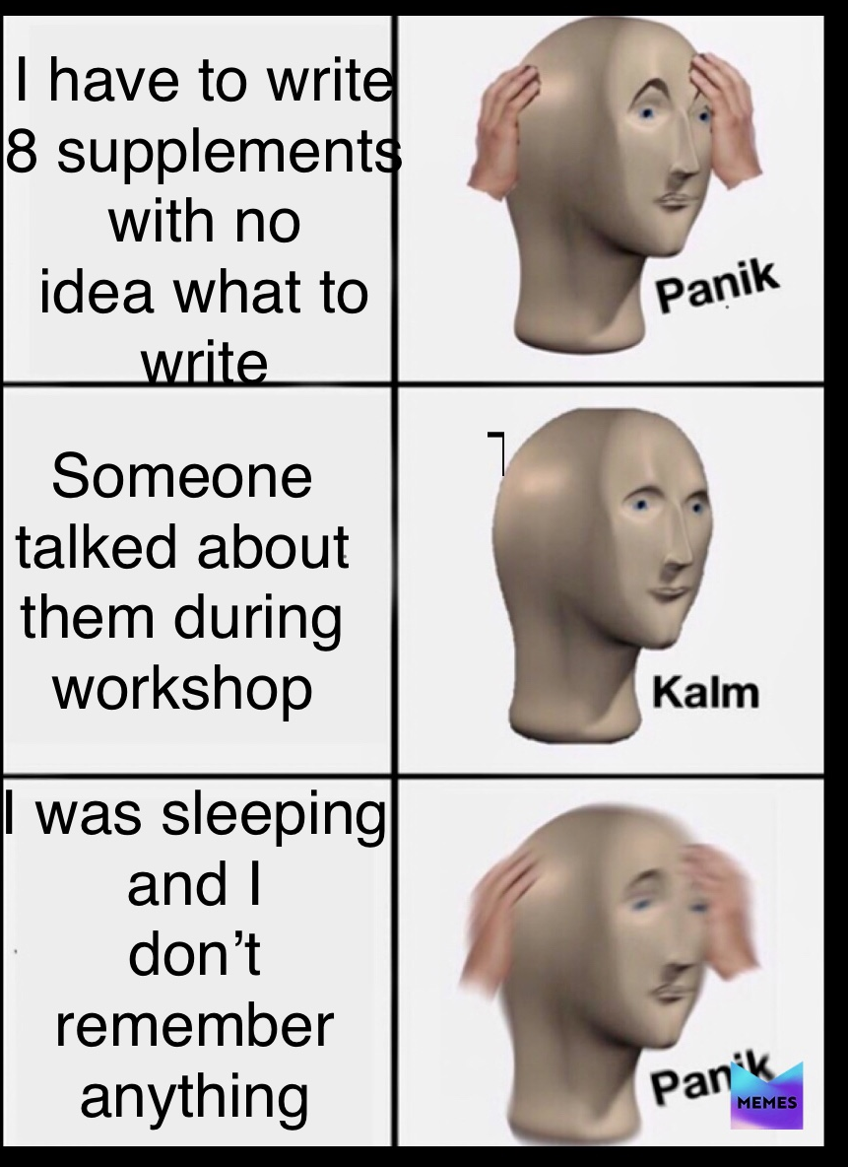

Slide 8

Why school essay
Requires that you state reasons for wanting to attend a specific school.
Finds out if you’re a good fit.
Show what the school is going to do for you and how you will contribute to the school community.
Avoid being superficial in your response.
Show you’re well researched.

Slide 9

Gap Year Essays
•Ask for your engagement after high school.
•Great chance to portray your intellectual curiosities e.g research work or community engagement.
•Write about the activity, even if ordinary, extraordinarily.

Slide 10


General tips for essay writing
Practice- you’ve to start from somewhere
Read viz. successful essays
Research esp. college specific essays
Grammarly
Answer the question
Get it done way before deadline ⌛️
🚫 DON’T PLAGIARIZE ❌
Relax! You can ace it!

Slide 11
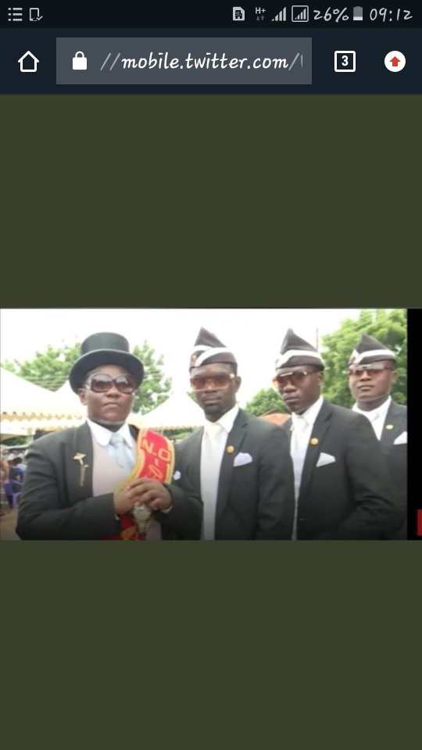
When the admissions officer finds out you plagiarized your essays...

Slide 12


Resources
YouTube
blog.prepscholar.com
https://apply.jhu.edu/application-process/essays-that-worked/
The Princeton Review
blog.collegevine.com

Slide 13
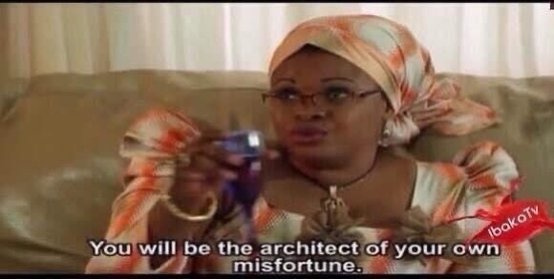
Well, if you refuse to take our advice…

